Slide 1


INOVAÇÃO, EMPREENDEDORISMO E TRANSFERÊNCIA DE TECNOLOGIA
FCUL – 2018/2019
Mestrado em Microbiologia
IST/FCUL
AULA 4
09 OUTUBRO 2018
Helena Vieira
Copyright ©

Slide 2
SUMMARY
Value Proposition. The concept of Value in exploiting and commercializing new products.
Value Proposition in the Business Model canvas.
Value Curve
Business opportunities
Intellectual Property protection. IP code and regulation at Ulisboa.

Slide 3
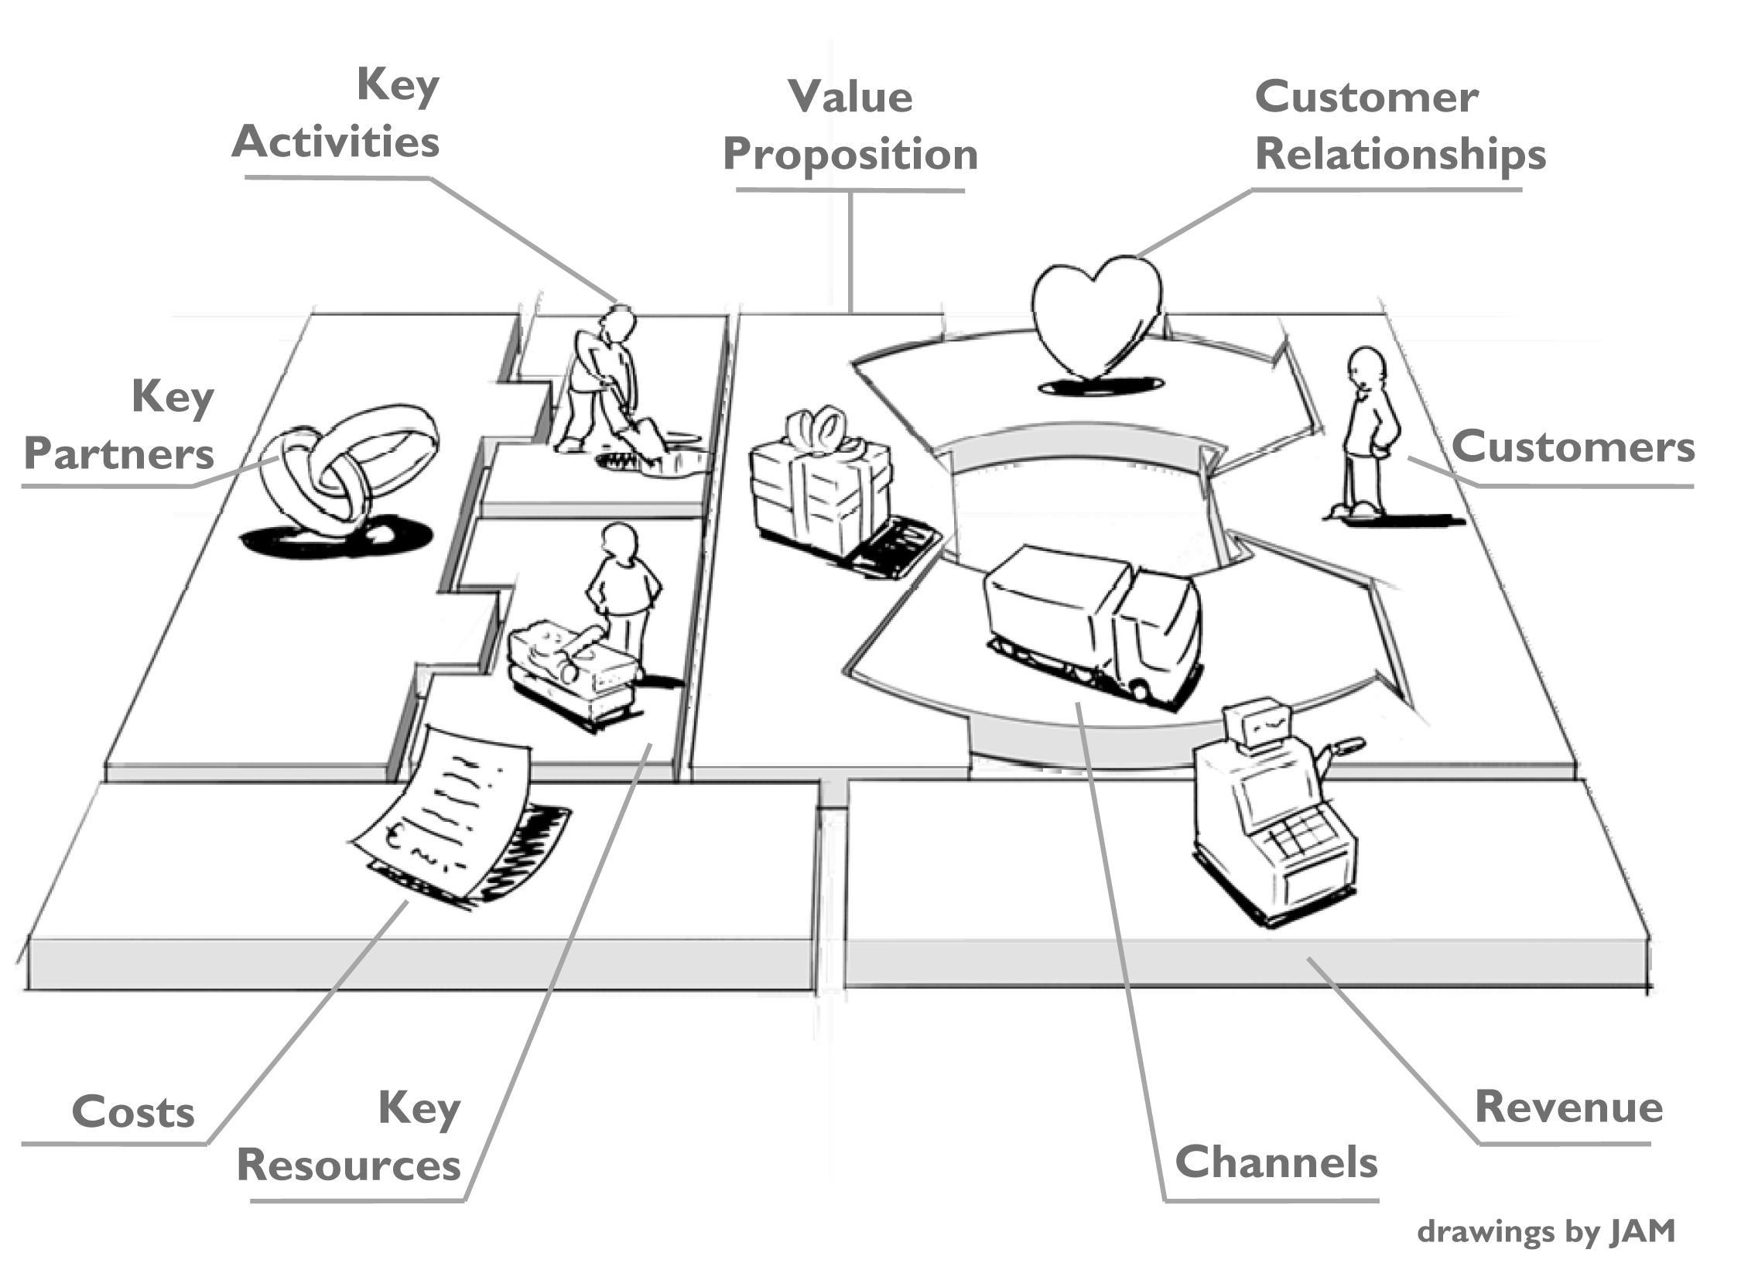
BUSINESS MODEL CANVAS
in: Business Model Generation, Alex Osterwalder & Yves Pigneur, 2009

Slide 4
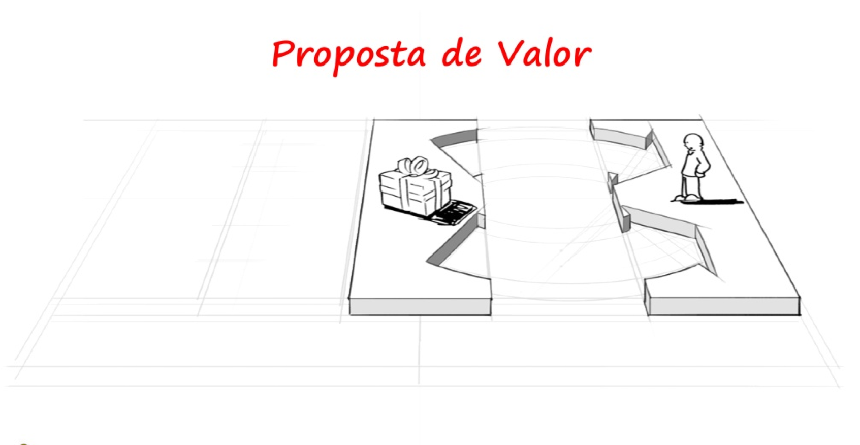
VALUE PROPOSITION

Slide 5
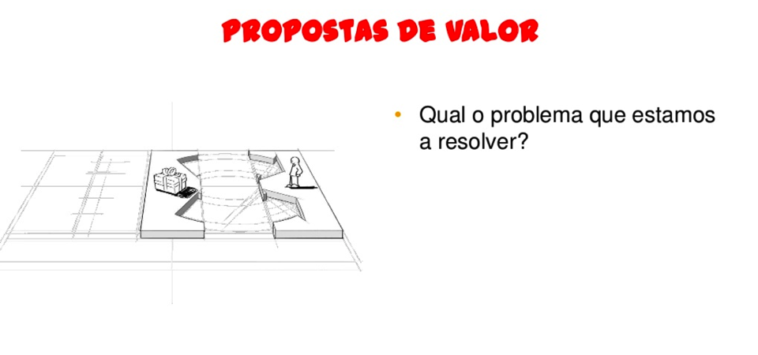
VALUE PROPOSITION
What problem/pain are we trying to solve?
What solution are we offering?
What is the value in our solution?

Slide 6
BUSINESS MODEL CANVAS
Helena Viera, PhD © 2017/2018
in: Business Model Generation, Alex Osterwalder & Yves Pigneur, 2009

Slide 7
VALUE PROPOSITION
Helena Viera, PhD © 2017/2018

Slide 8
VALUE PROPOSITION
What problem/pain are we trying to solve?
What solution are we offering?
What is the value in our solution?
Helena Viera, PhD © 2017/2018

Slide 9
VALUE PROPOSITION
It’s what explains the benefits I am generating for my customers/users from my service/product.
The value generated can be material or imaterial.
Helena Viera, PhD © 2017/2018

Slide 10
TO BUILD VALUE....
YOU MUST FEEL LIKE YOUR CUSTOMER!
YOU MUST LISTEN TO THEIR FEARS; NEEDS AND LIKES! (not yours!)
Helena Viera, PhD © 2017/2018

Slide 11
Helena Viera, PhD © 2017/2018
Notes:
GAINS: Gains describe the outcomes and benefits your customers want. Some gains are required, expected, or desired by customers, and some would surprise them. Gains include functional utility, social gains, positive emotions, and cost savings.
JOBS: Jobs describe the things your customers are trying to get done in their work or in their life. A customer job could be the tasks they are trying to perform and complete, the problems they are trying to solve, or the needs they are trying to satisfy.
PAINS: Pains describe anything that annoys your customers before, during, and after trying to get a job done or simply prevents them from getting a job done. Pains also describe risks, that is, potential bad outcomes, related to getting a job done badly or not at all.
GAIN CREATORS: Gain Creators describe how your products and services create customer gains. They explicitly outline how you intend to produce outcomes and benefits that your customer expects, desires, or would be surprised by, including functional utility, social gains, positive emotions, and cost savings.
GAINS:
Which savings would make your customers happy? Which savings in
terms of time, money, and effort would they value?
What quality levels do they expect, and what would they wish
for more or less of?
How do current value propositions delight your customers? Which specific
features do they enjoy? What performance and quality do they expect?
What would make your customers’ jobs or lives easier? Could there be
a flatter learning curve, more services, or lower costs of ownership?
What positive social consequences do your customers desire?
What makes them look good? What increases their power or their status?
What are customers looking for most? Are they searching for good
design, guarantees, specific or more features?
What do customers dream about? What do they aspire to achieve,
or what would be a big relief to them?
How do your customers measure success and failure? How do they
gauge performance or cost?
What would increase your customers’ likelihood of adopting a
value proposition? Do they desire lower cost, less investment,
lower risk, or better quality?
JOBS: What is the one thing that your customer couldn’t live without
accomplishing? What are the stepping stones that could help your
customer achieve this key job?
What are the different contexts that your customers might be in? How do
their activities and goals change depending on these different contexts?
What does your customer need to accomplish that involves interaction
with others?
What tasks are your customers trying to perform in their work or personal
life? What functional problems are your customers trying to solve?
Are there problems that you think customers have that they may not
even be aware of?
What emotional needs are your customers trying to satisfy?
What jobs, if completed, would give the user a sense of self-satisfaction?
How does your customer want to be perceived by others? What can your
customer do to help themselves be perceived this way?
How does your customer want to feel? What does your customer need to
do to feel this way?
Track your customer’s interaction with a product or service throughout
its lifespan. What supporting jobs surface throughout this life cycle?
Does the user switch roles throughout this process?
PAINS: How do your customers define too costly? Takes a lot of time, costs too much money, or requires substantial efforts?
What makes your customers feel bad? What are their frustrations,
annoyances, or things that give them a headache?
How are current value propositions under performing for your customers?
Which features are they missing? Are there performance issues that annoy them or malfunctions they cite?
What are the main difficulties and challenges your customers encounter? Do they understand how things work, have difficulties getting certain things done, or resist particular jobs for specific reasons?
What negative social consequences do your customers encounter or fear? Are they afraid of a loss of face, power, trust, or status?
What risks do your customers fear? Are they afraid of financial, social,
or technical risks, or are they asking themselves what could go wrong?
What’s keeping your customers awake at night? What are their big issues,
concerns, and worries?
What common mistakes do your customers make? Are they using a solution the wrong way?
What barriers are keeping your customers from adopting a value
proposition? Are there upfront investment costs, a steep learning curve,
or other obstacles preventing adoption?

Slide 12
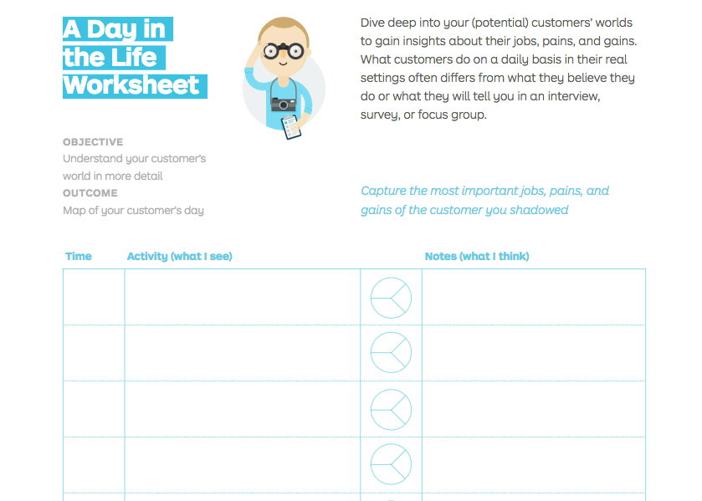
Helena Viera, PhD © 2017/2018

Slide 13

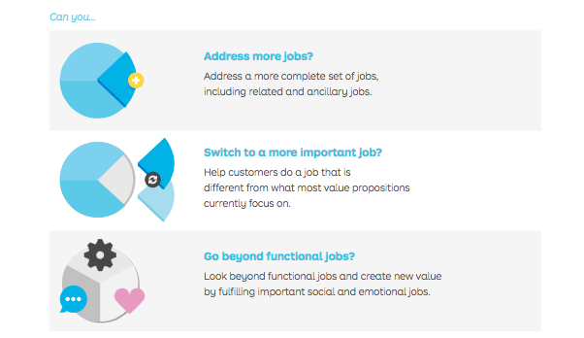
Helena Viera, PhD © 2017/2018

Slide 14
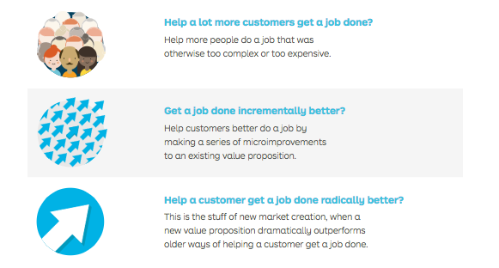
Helena Viera, PhD © 2017/2018

Slide 15

Helena Viera, PhD © 2017/2018
Notes:
Aora que eu já sei quem são os meus clientes, já posso falar com eles e saber/descobrir o que precisam e querem!

Slide 16
VALUE PROPOSITION (1)
A business or marketing statement that summarizes why a consumer should buy a product or use a service.
This statement should convince a potential consumer that one particular product or service will add more value or better solve a problem than other similar offerings.
Source: Forbes magazine
Helena Viera, PhD © 2017/2018

Slide 17
VALUE PROPOSITION (2)
Keep it short and uncluttered. If you can't sum it up in 10 words or less, chances are you won't be able to execute it either.
Be precise. Your customers have specific needs; your value proposition should offer targeted solutions
This is about your customer, not you. Your value proposition should discuss only what matters to your customers and the value you can bring to them.
Value comes in numerous forms. Money, time, convenience and superior service are a few of the ways you can help deliver value to your customers.
Helena Viera, PhD © 2017/2018

Slide 18
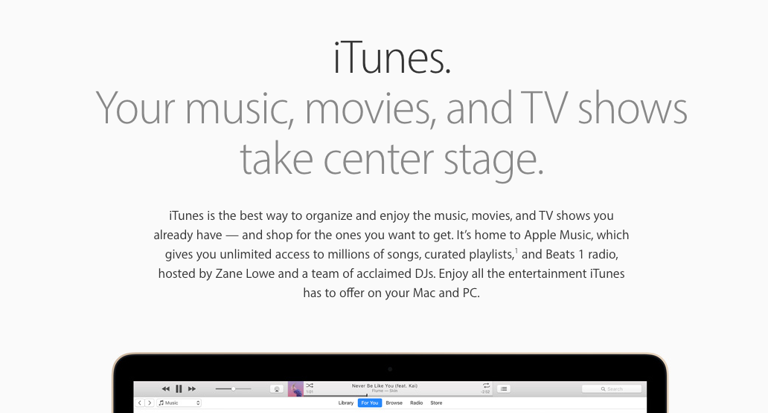
Helena Viera, PhD © 2017/2018

Slide 19
Helena Viera, PhD © 2017/2018

Slide 20
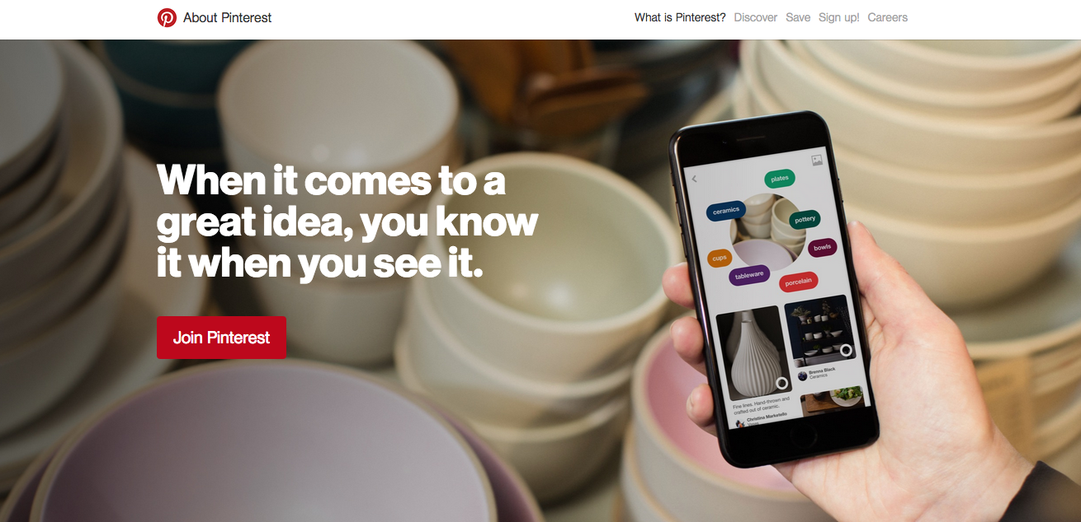
Helena Viera, PhD © 2017/2018

Slide 21
Helena Viera, PhD © 2017/2018

Slide 22
Helena Viera, PhD © 2017/2018

Slide 23
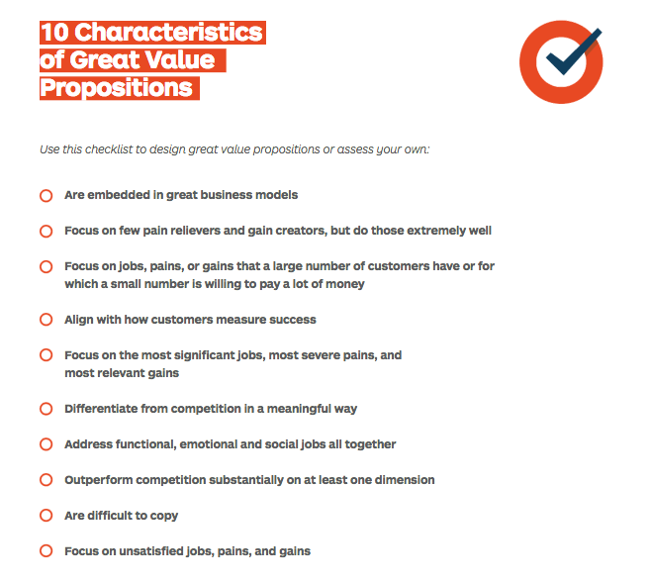
Helena Viera, PhD © 2017/2018

Slide 24
VALUE CURVE
“Strategy is what a company decides NOT to do well”
Francis Frei, Harvard Business School

Slide 25
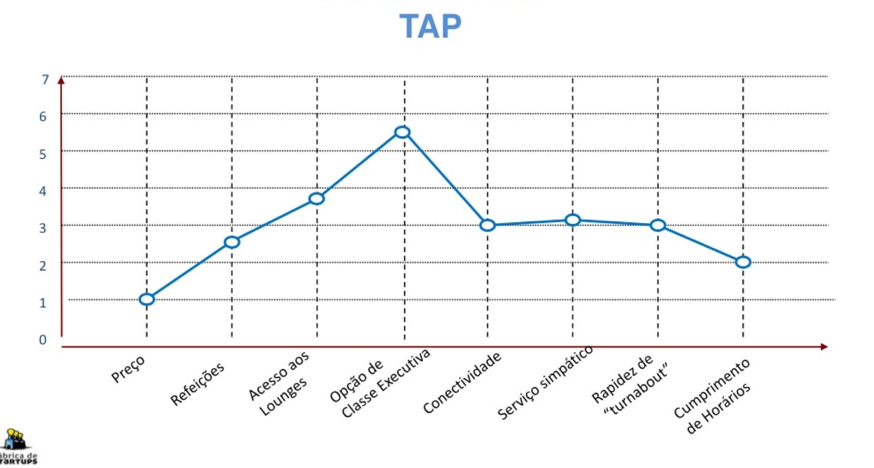
VALUE CURVE

Slide 26
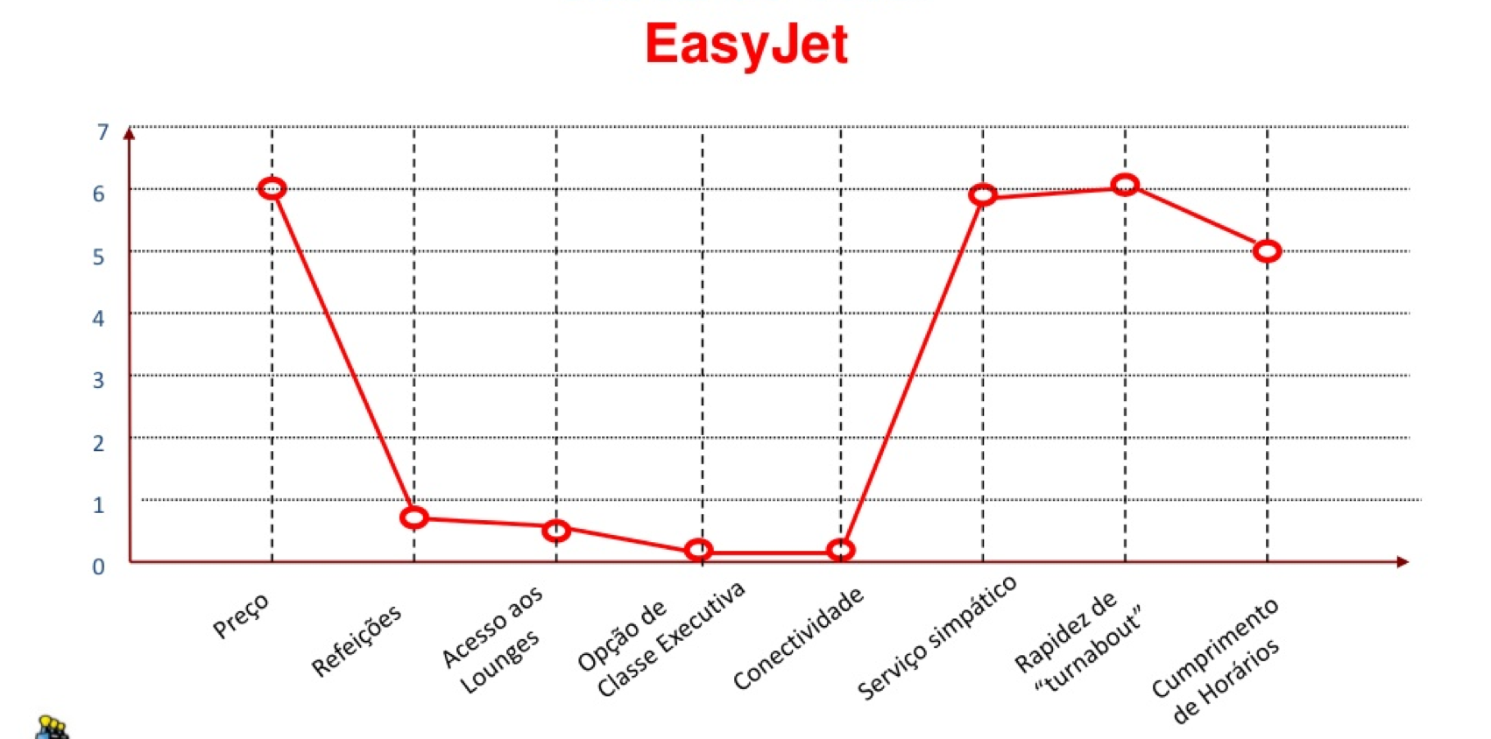
VALUE CURVE

Slide 27
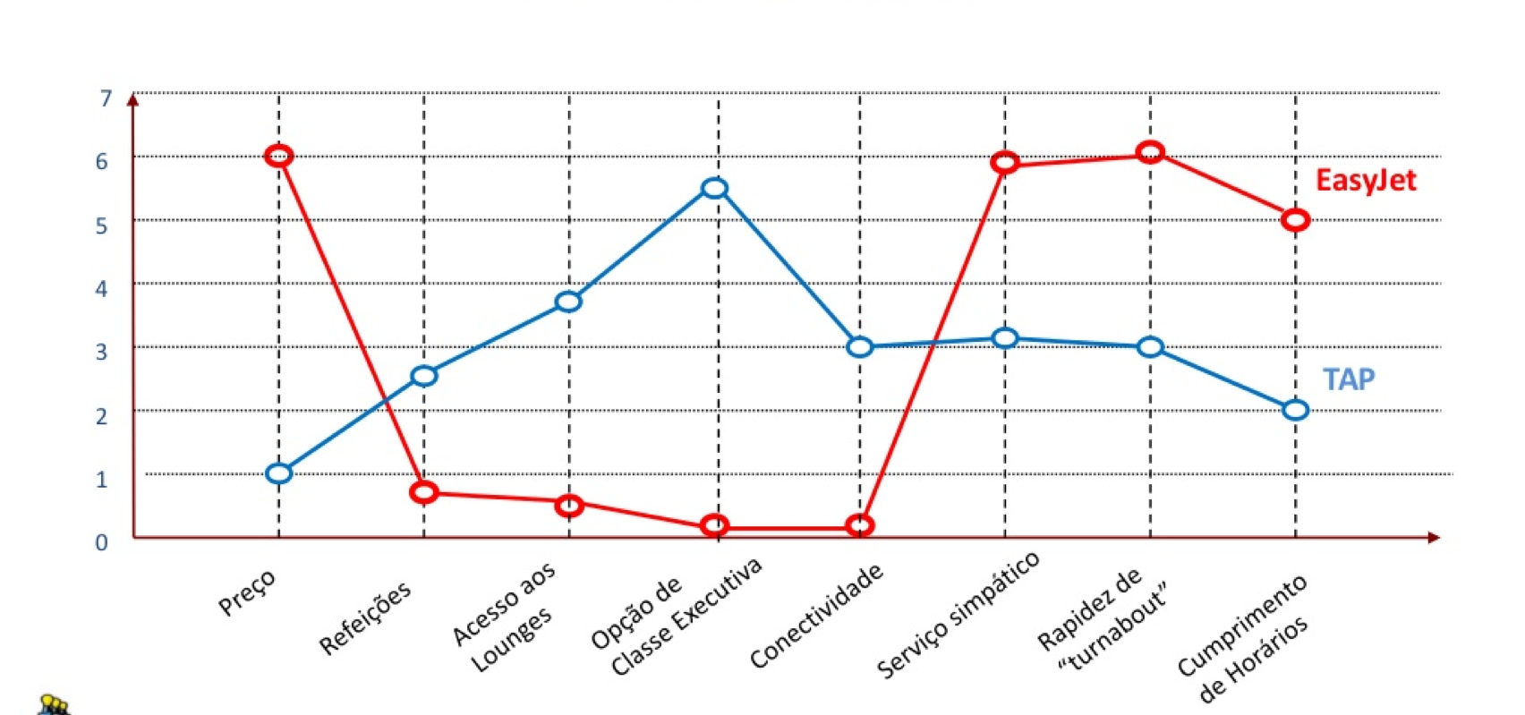
VALUE CURVE

Slide 28
EXERCISE – VALUE CURVE
Attribute identification
Get all the elements of your group together
Each one will individually think and write on 5 post-it the 5 key differentiation factors from your competition
Put all post it together
Group the post it in similarity attributes groups
Select the most relevant 8 and build your value curve (scale 1-7)

Slide 29
VALUE CURVE ATTRIBUTES
Design
Convenience
Availability
Price
Exclusivity
Personalized
Faster access
Eco-labbeled
Organic
Simplicity
Ambience
Fun
Knowledge access
Quality
Capacity
Variety
Location…

Slide 30
VALUE CURVE
Questions you should ask (Francis Frei)
What is the experience your clients want?
What are the attributes your clients value the most?
Can we distinguish ourselves from our competition by the experience we can provide our clients?

Slide 31
BLUE OCEAN STRATEGY
Theory of Strategy developed by INSEAD teachers W.Chan Kim & Renee Maugbourne.
DO NOT focus on competing in EXISTING MARKETS
Rather, focus on CREATING NEW MARKET SPACES and making the competition IRRELEVANT.

Slide 32
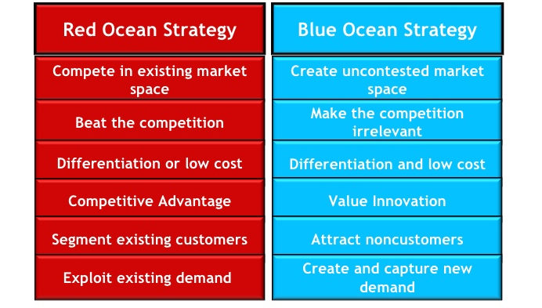
BLUE OCEAN Vs RED OCEAN

Slide 33
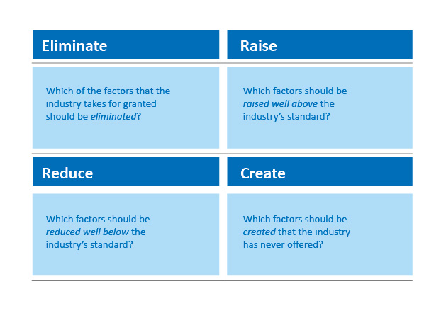
BLUE OCEAN STRATEGY

Slide 34

https://www.youtube.com/watch?v=QaZkX7FW8QU
Notes:
The Marvel Way: Restoring a Blue Ocean
Author(s): KIM, W. Chan, MAUBORGNE, Renée, OLENICK, Michael
The Marvel Way: Restoring a Blue Ocean explains one of the greatest turnarounds in modern business history.
This case comes with a two-part video interview with CEO Peter Cuneo who launched a Blue Ocean.
Founded in 1939, Marvel Comics initially struggled in a red ocean producing primarily me-to knock-off comic books. In the early 1960’s the business took a blue ocean turn by focusing on noncustomer college students. Marvel invented characters that were people first and superheroes second: Spider-Man, The Hulk, Iron Man, the X-Men. The business thrived.
By the 1980’s value extractors took over Marvel, badly misaligning value, profit, and people. In late 1996 Marvel filed for bankruptcy, a victim of red ocean management practices. New management purchased the business out of bankruptcy in 1998 but faced a daunting task: Marvel owed $30 million in annual interest payments on a $250 million loan, cash was so tight that they almost missed payroll, and movie rights for many of their best characters were licensed to others.
First managers stabilized the business then Marvel created a new type of blue ocean that went on to produce the most profitable movie franchise in history. Just over a decade after exiting bankruptcy a debt-free Marvel sold itself to Disney for $4.2 billion.
Learning objective:
Learn how to use Blue Ocean Strategy to pivot from a red to a blue ocean. Teach the importance of aligning value, profits and people. Explain the difference between value extraction and value innovation, and the financial and ethical ramifications of each.

Slide 35
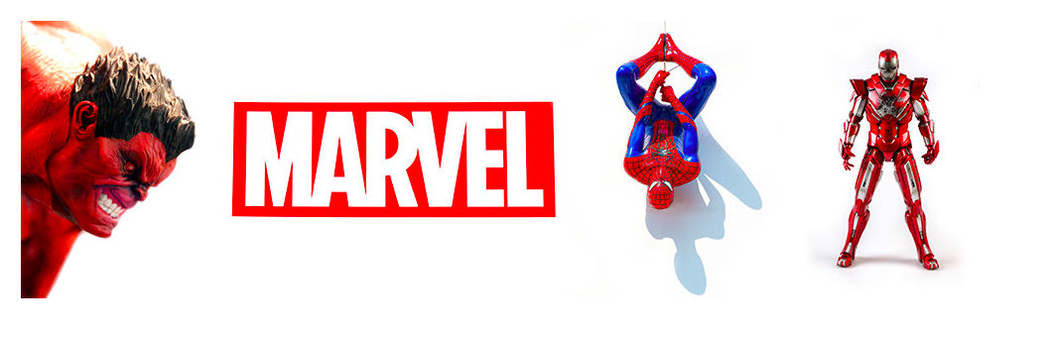
Founded in 1938, Marvel Comics initially struggled in a red ocean producing primarily me-to knock-off comic books
In the early 1960’s Marvel does a blue ocean turn by focusing on noncustomer college students – inventing new characters that were human 1st and heroes 2nd (Spiderman, Iron Man…)
By the 1980’s the value extractors turned the business down and in 1996 they filled bankruptcy
In 1998 new management bought the company – licensed rights over best characters and implemented the most profitable movie franchise in history
After 10 years they were debt free and sold to Disney for $4.2Billion dollars!
Notes:
The Marvel Way: Restoring a Blue Ocean
Author(s): KIM, W. Chan, MAUBORGNE, Renée, OLENICK, Michael
The Marvel Way: Restoring a Blue Ocean explains one of the greatest turnarounds in modern business history.
This case comes with a two-part video interview with CEO Peter Cuneo who launched a Blue Ocean.
Founded in 1939, Marvel Comics initially struggled in a red ocean producing primarily me-to knock-off comic books. In the early 1960’s the business took a blue ocean turn by focusing on noncustomer college students. Marvel invented characters that were people first and superheroes second: Spider-Man, The Hulk, Iron Man, the X-Men. The business thrived.
By the 1980’s value extractors took over Marvel, badly misaligning value, profit, and people. In late 1996 Marvel filed for bankruptcy, a victim of red ocean management practices. New management purchased the business out of bankruptcy in 1998 but faced a daunting task: Marvel owed $30 million in annual interest payments on a $250 million loan, cash was so tight that they almost missed payroll, and movie rights for many of their best characters were licensed to others.
First managers stabilized the business then Marvel created a new type of blue ocean that went on to produce the most profitable movie franchise in history. Just over a decade after exiting bankruptcy a debt-free Marvel sold itself to Disney for $4.2 billion.
Learning objective:
Learn how to use Blue Ocean Strategy to pivot from a red to a blue ocean. Teach the importance of aligning value, profits and people. Explain the difference between value extraction and value innovation, and the financial and ethical ramifications of each.

Slide 36
EXERCISE & TEST
Built your 1st BMC
Look at your CS – What can be value to them?
What are their Pains, Jobs and gains?
Build your Value Canvas!
What are your hypothesis? Define all possible!
  Choose the 3 most important/risky ones!
If you can, interview someone that may be a client and LISTEN to their problems & needs BEFORE presenting them the solution!
Helena Viera, PhD © 2017/2018

Slide 37
HOMEWORK
Get to know your industry and competitors
Select the 2 most relevant ones
Compare your project to those competitors
Build your comparable value curve and learn your strategy/value

Slide 38
EXERCISE & TEST
Prepare a google form questionaire
  Include this sentence in ALL your forms:
  “This is part of a student assignment for an entrepreneurial course in the FCUL, and the ideas, questions and all information herein contained is only theoretical and imaginary, not part of a yet real solution and it is of student’s entire responsibility. The purpose of this questionnaire is to listen to the market and potential customers needs on the bases of a fictional idea. We can assure you that every information here is maintained confidential and will solely be used with the purpose of getting statistical significant data.“
  Demographic info: name, age, degree, nationality, gender…
  Ask specific questions and provide optional answers (don’t do open questions)
    Ex: When you go to a new job outside your country what are the firts things you do?
      A) look for a place
      B) Know more about job
      c() learn the entry needs for that country...

Slide 39
EXERCISE & TEST
Collect as many answers as you can – Facebook, LinkedIn, email to groups, phone calls, presence interviews etc…
Analyse the data with the google summary tool
Validate or not validate your hypothesis!

Slide 40
INVENTIONS & PROTECTION
Protection guarantees some sort of exclusivity
Must we Protect EVERYTHING?

Slide 41
Intellectual Property
Intellectual Property (IP) protection guarantees the inventor of a new process or product to benefit from, or allow others to take profit from, the exploitation of that IP, either financially or other, preventing the possibility of unfair use of it by third parties.

Slide 42
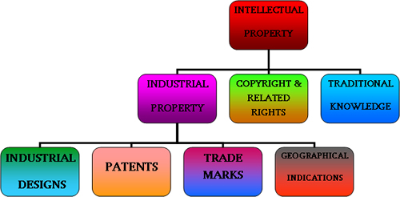

Slide 43
PATENTS
A patent is a monopolist right given to the inventor for a period of up to 20 years, depending on national laws, that is restricted to the details and claims defined in the patent’s document.
Only new, inventive and industrially suitable inventions can be patented.

Slide 44
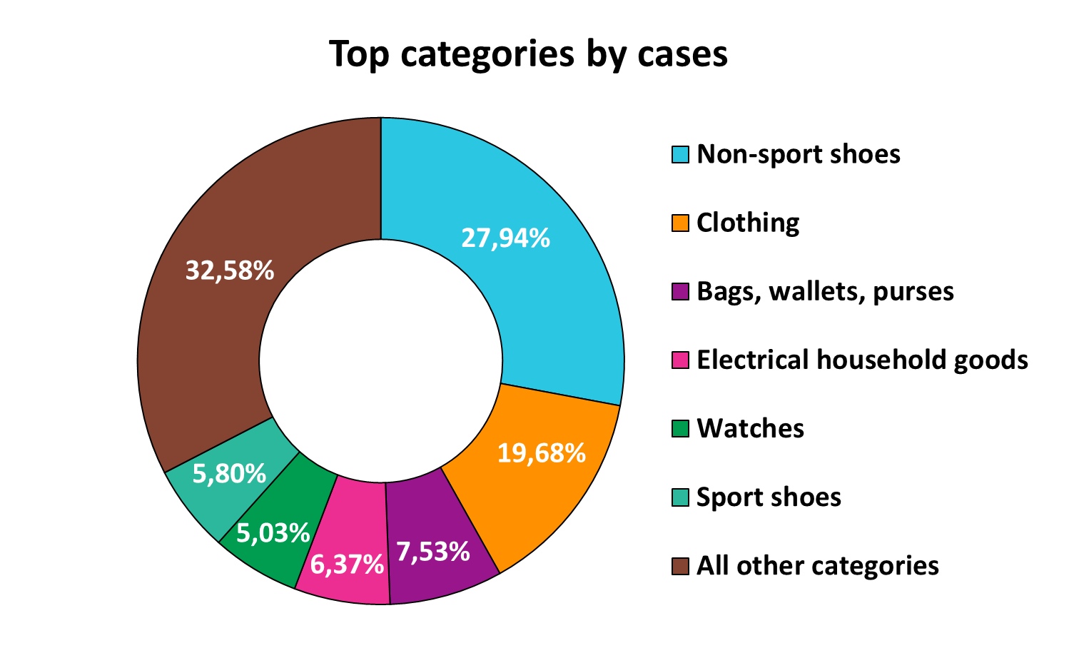

Slide 45
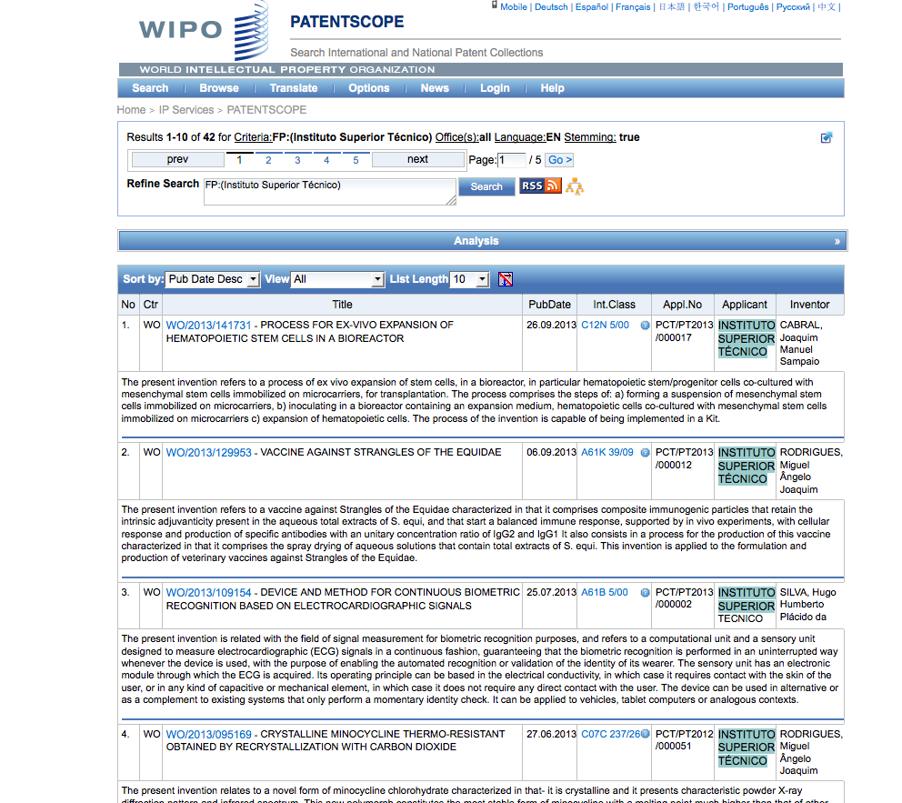

Slide 46
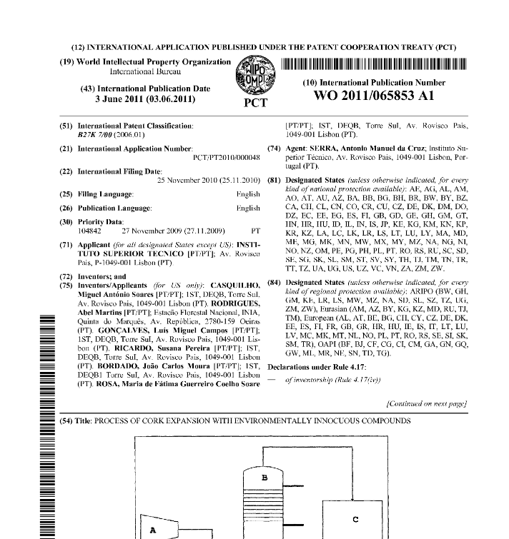
PATENTS

Slide 47
PATENTS
What can NOT be patented:
  Live organisms
  Original DNA sequences/genes
  Anything in nature
  Software
What CAN be patented:
  Uses/production methods of live organisms
  Modified/recombinant DNA sequences, vectors and methods
  Anything that is modified from nature
  Usage of a code/algorithm

Slide 48
PATENTS DATABASES
www.inpi.pt
www.wipo.com
https://www.epo.org/index.html

Slide 49
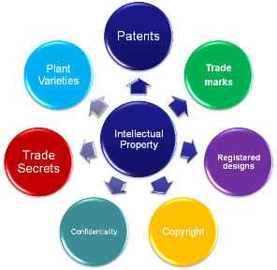

Slide 50
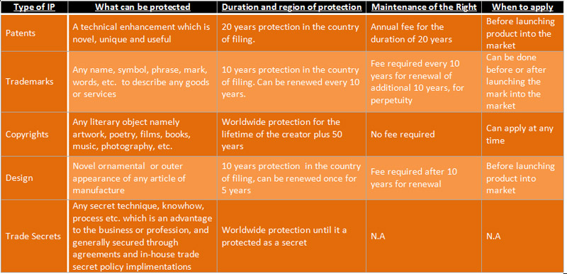

Slide 51
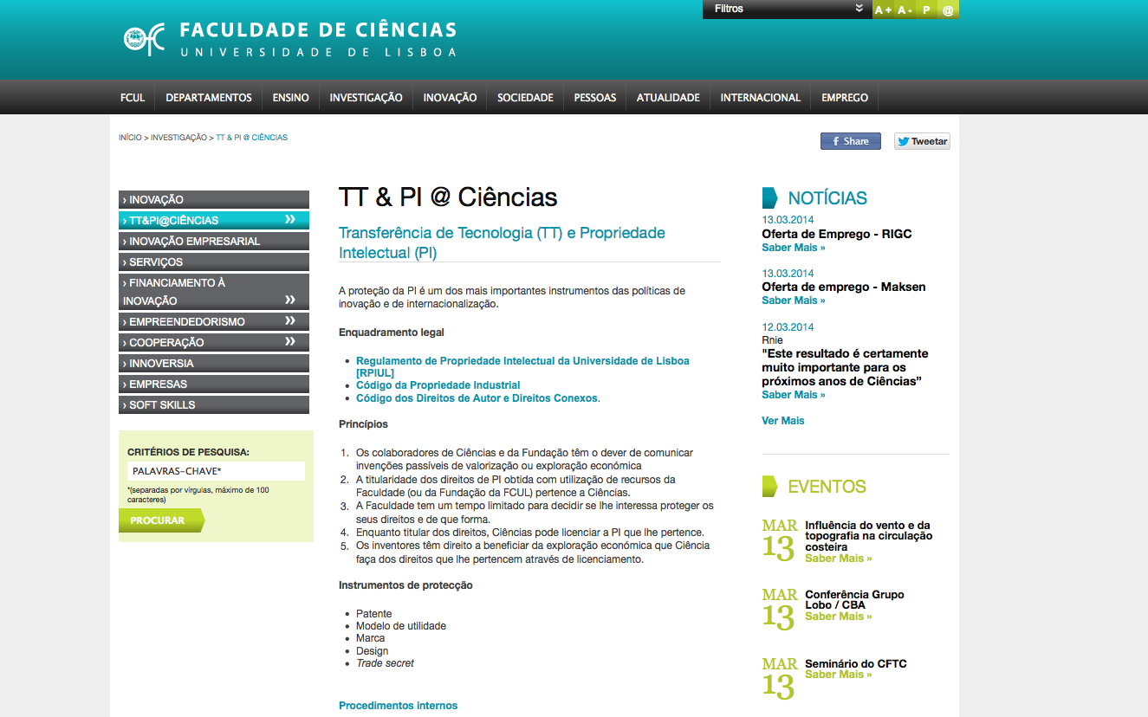
The IP CODE of ULISBOA
http://www.fc.ul.pt/pt/pagina/386/tt-pi-ciências

Slide 52
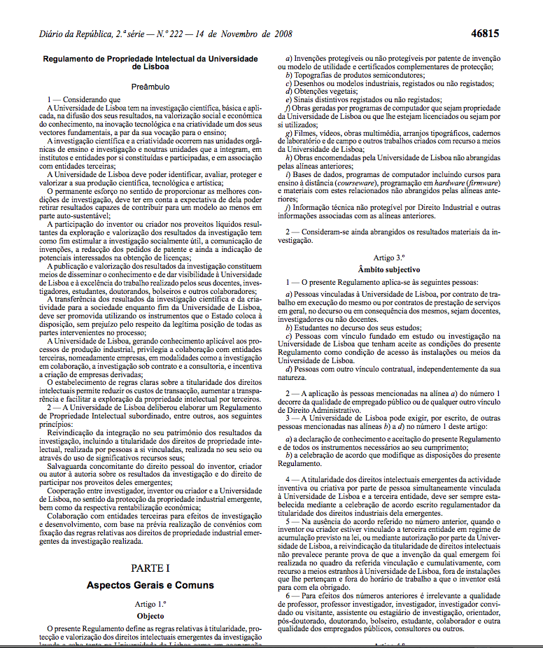
The IP CODE of ULISBOA
http://www.fc.ul.pt/pt/pagina/386/tt-pi-ciências

Slide 53
The IP CODE of ULISBOA
KEY POINTS
All the rights over R&D performed in UL belong to UL
The inventor has the right to be recognised as so in any IP piece or communication (or not if he/she desires so)
The inventor shall communicate the invention to UL (Via TT@UL) maximum 1 month after invention was made
If UL has no interest in protecting the IP, it can give partial or full rights to inventor
http://www.fc.ul.pt/pt/pagina/386/tt-pi-ciências

Slide 54
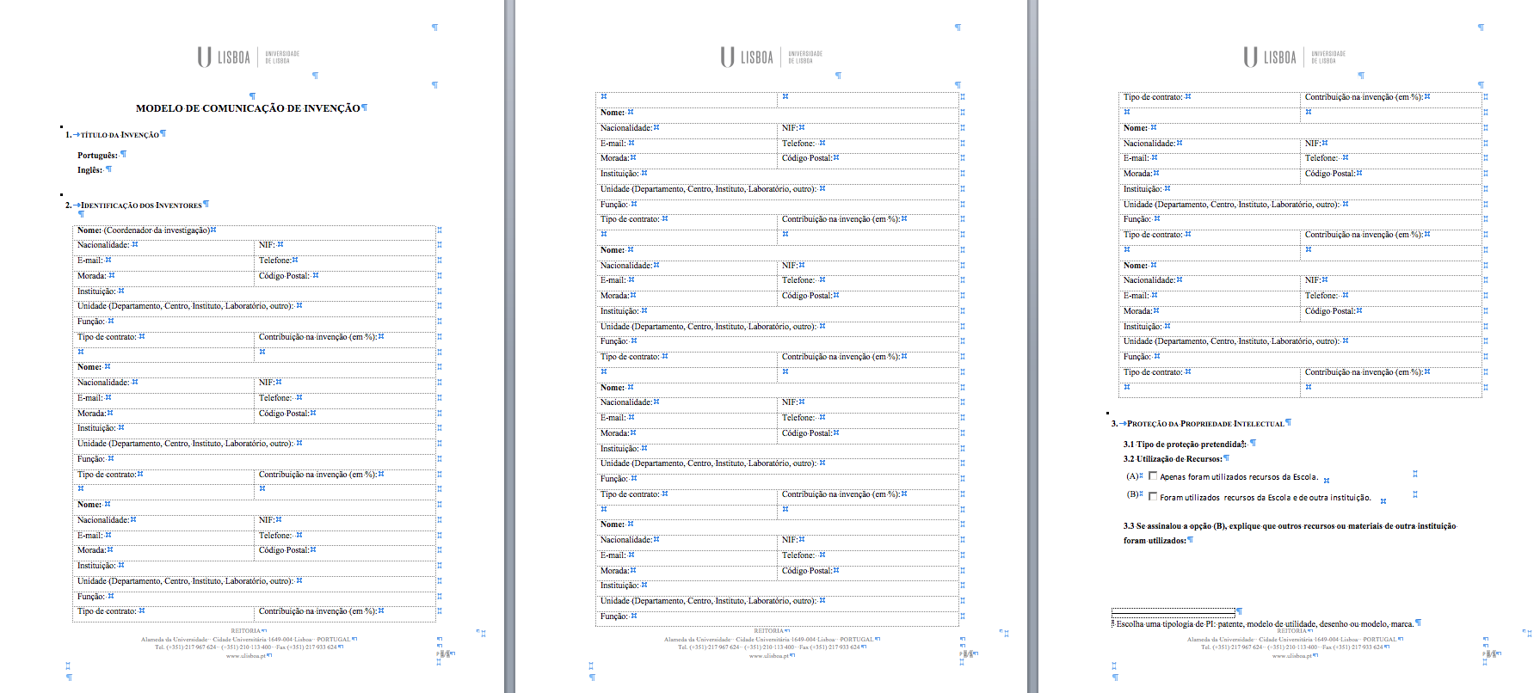
The IP CODE of ULISBOA
1st Step– Invention communication
http://www.fc.ul.pt/pt/pagina/386/tt-pi-ciências

